Slide 1
Statistical Natural Language Parsing
An exponential number of attachments

Slide 2
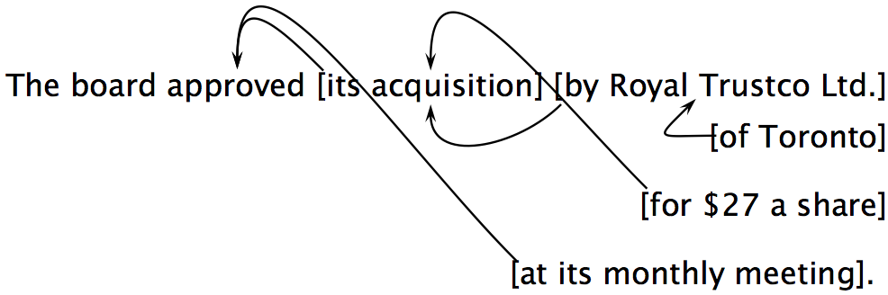
Attachment ambiguities
A key parsing decision is how we ‘attach’ various constituents
PPs, adverbial or participial phrases, infinitives, coordinations, etc.
Catalan numbers: C_{n} = (2n)!/[(n+1)!n!]
An exponentially growing series, which arises in many tree-like contexts:
E.g., the number of possible triangulations of a polygon with n+2 sides
Turns up in triangulation of probabilistic graphical models….
Notes:
No constraints, just exponential 2^n
But normally assuming nesting: at its monthly meeting could modify “for $27 a share or “its acquisition” or “aproved”, but not “by Roay Trustco Ltd.” or “of Toronto

Slide 3
Attachment ambiguities
A key parsing decision is how we ‘attach’ various constituents
PPs, adverbial or participial phrases, infinitives, coordinations, etc.
Catalan numbers: C_{n} = (2n)!/[(n+1)!n!]
An exponentially growing series, which arises in many tree-like contexts:
E.g., the number of possible triangulations of a polygon with n+2 sides
Turns up in triangulation of probabilistic graphical models….
Notes:
No constraints, just exponential 2^n
But normally assuming nesting: at its monthly meeting could modify “for $27 a share or “its acquisition” or “aproved”, but not “by Roay Trustco Ltd.” or “of Toronto

Slide 4
Quiz Question!
How many distinct parses does the following sentence have due to PP attachment ambiguities?
A PP can attach to any preceding V or N within the verb phrase, subject only to the parse still being a tree.
(This is equivalent to there being no crossing dependencies, where if d₂ is a dependent of d₁ and d₃ is a dependent of d₂, then the line d₂–d₃ begins at d₂ under the line from d₁ to d₂.)
John wrote the book with a pen in the room.

Slide 5
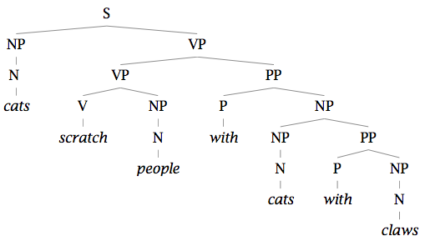
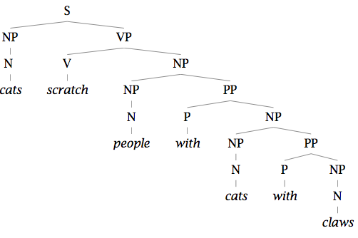
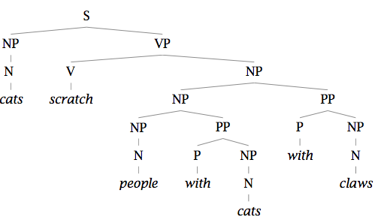
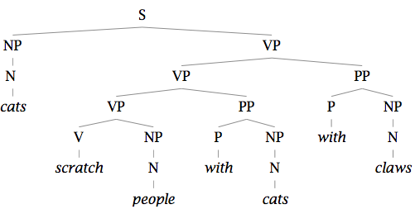
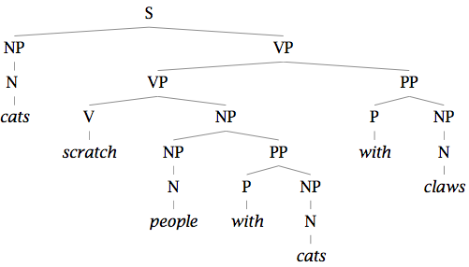
Two problems to solve: 1. Repeated work…

Slide 6
Two problems to solve: 1. Repeated work…

Slide 7
Two problems to solve: 2. Choosing the correct parse
How do we work out the correct attachment:
She saw the man with a telescope
Is the problem ‘AI complete’? Yes, but …
Words are good predictors of attachment
Even absent full understanding
Moscow sent more than 100,000 soldiers into Afghanistan …
Sydney Water breached an agreement with NSW Health …
Our statistical parsers will try to exploit such statistics.

Slide 8
Statistical Natural Language Parsing
An exponential number of attachments

